Slide 1
Green Thumb Gardening
Project Presentation

Slide 2
Background
What is Green Thumb Gardening?
Green Thumb Gardening is a leading plant and seed selling company that approach their customers with wide range of additional services such as garden maintenance tools and services.

Slide 3
Purpose
Completion of this project enables the customer to order their products and services online and make payments online without any interactions with the employees or public prior to service.
Proposed system will be beneficial for customers as well as to the business.

Slide 4
Objectives
Customer should be able to order products and services online.
Customer should be able to make the payments online.
Customer should be able to rate and give the feedback online.
Employee should be able to add, update, delete and check the inventories online.
Employee should be able to generate reports through the system.
System should simplify the daily operations and managerial tasks.

Slide 5
Scope
Study the current operations and progress they making with current system using online resources.
The implementation of the website has to be finished within specified time frame.
During the project, between project development team and between the team and the customer should have a better frequent communication with the updates.
As the first deployment of the website it will only allow the most essential basic functionalities.

Slide 6
Limitations
For the implementation there will be limited data access as it has been operated manually.
Also it will be limited on methods to collect the data and data collection process.
To accomplish the project there will be a limited time constraints.
Lack of human resources for the completion of the project.

Slide 7
Key Deliverables
The user will be capable of listing out particular product for particular service and give feedback/ review for services or products
The user will be capable of selecting rating for services and check business hours
The user will be capable of hiring gardener and mower from the website.
The user will be able to open new account by registering in the system and login to the system with the valid details
The user will be able to view the brief details of all the products and List out all the products
The user will be able to view delivery charges, the availability of the store, the discounted product along with the services provided

Slide 8
Functional Requirements (user)
Sign in
Login details
Forget/ reset password
List out products
View product details
View store availability
View discounted products
View available services
Review/feedback

Slide 9
Continued....
Select rating
Check business hours
Hire services
Edit job description
View delivery charges
Payment form

Slide 10
Continued… (for admin)
Admin login
View user
Forget password
Dashboard
Statics
Manage user request
Add products and services
logout

Slide 11
Non Functional requirements
Security
Availability
Performance
Scalability
Usability
Reliability
Maintainability

Slide 12
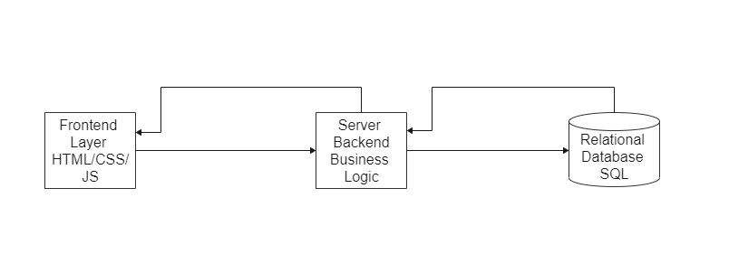
System Architecture

Slide 13
The whole system is based on 3 tier architecture
1st layer is the frontend layer, containing the page layout and design
Mid layer is considered as backend or server side layer, containing all the business logic i.e. login, signup, order handling, payment gateway and database connections.
Last layer is the database layer. It contains all the data related to the system

Slide 14
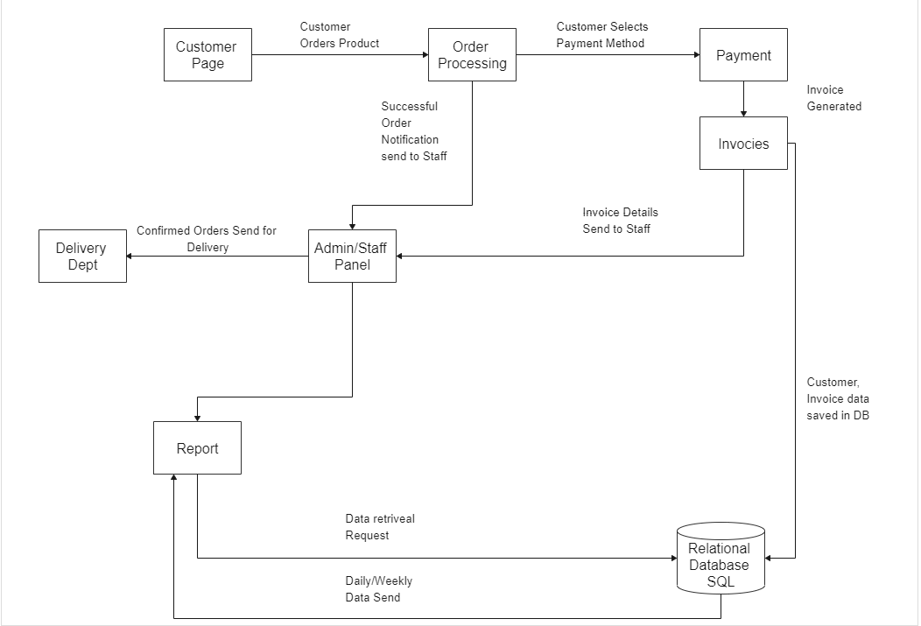
Software Architecture

Slide 15
There will be 2 views. i.e. customer panel and admin/staff panel
The data will be passed from frontend pages to the server side
All the necessary data will be stored in database. i.e. order details, invoices and etc.
Confirmed order notification will displayed on admin/staff panel
Staff can also generate report using admin/staff panel
Staff will forward the request of delivery to delivery dpt.

Slide 16
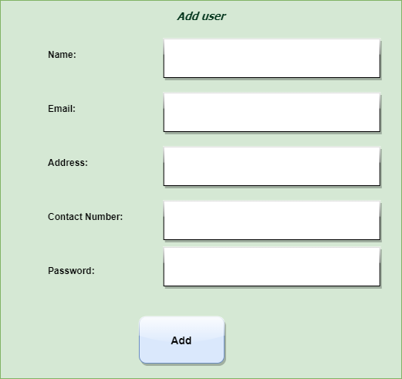
User Interface

Slide 17
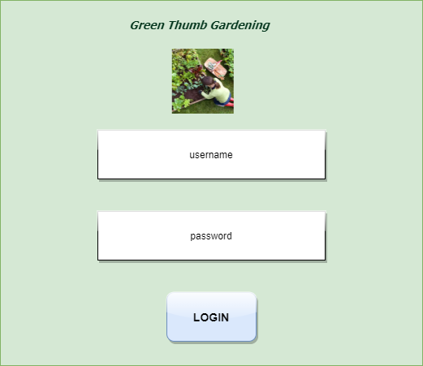
User Interface

Slide 18
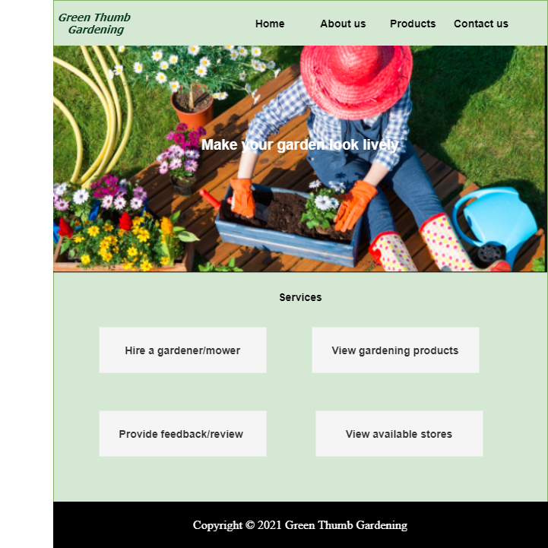
User Interface

Slide 19
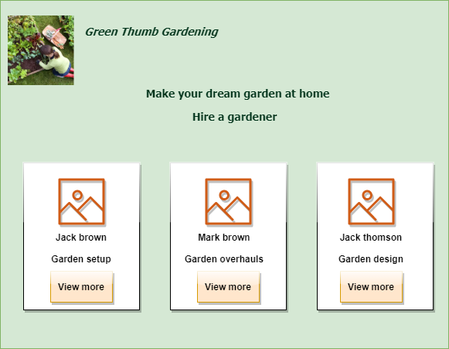
User Interface

Slide 20
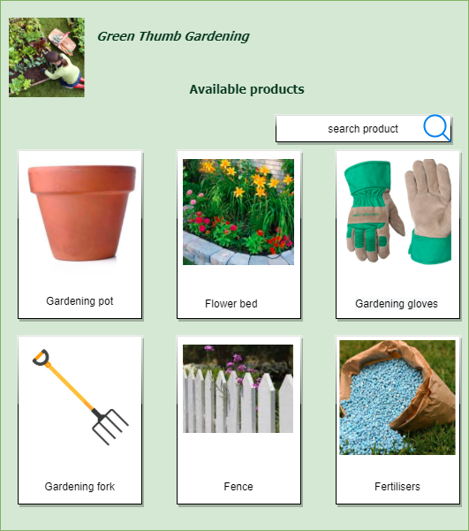
User interface

Slide 21
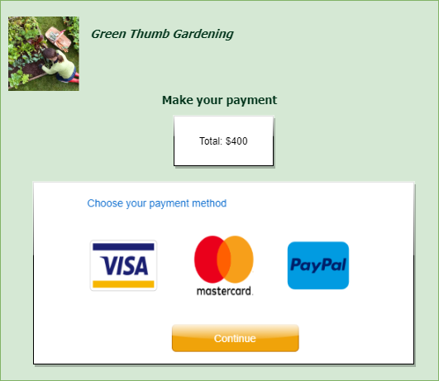
User interface

Slide 22
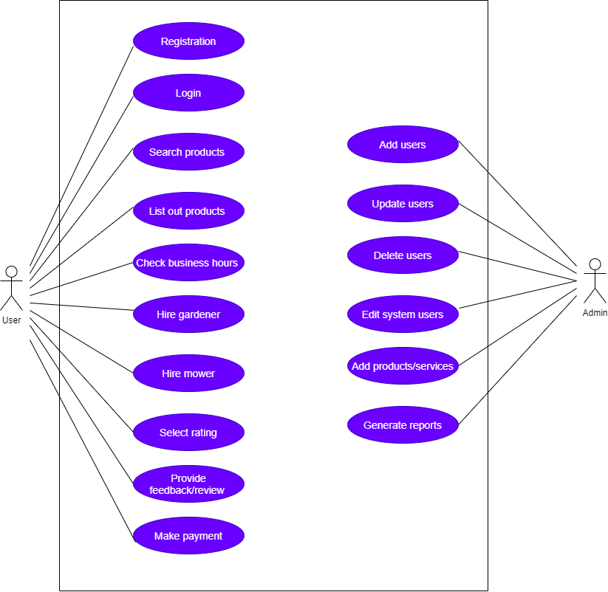
Use Case Diagram

Slide 23
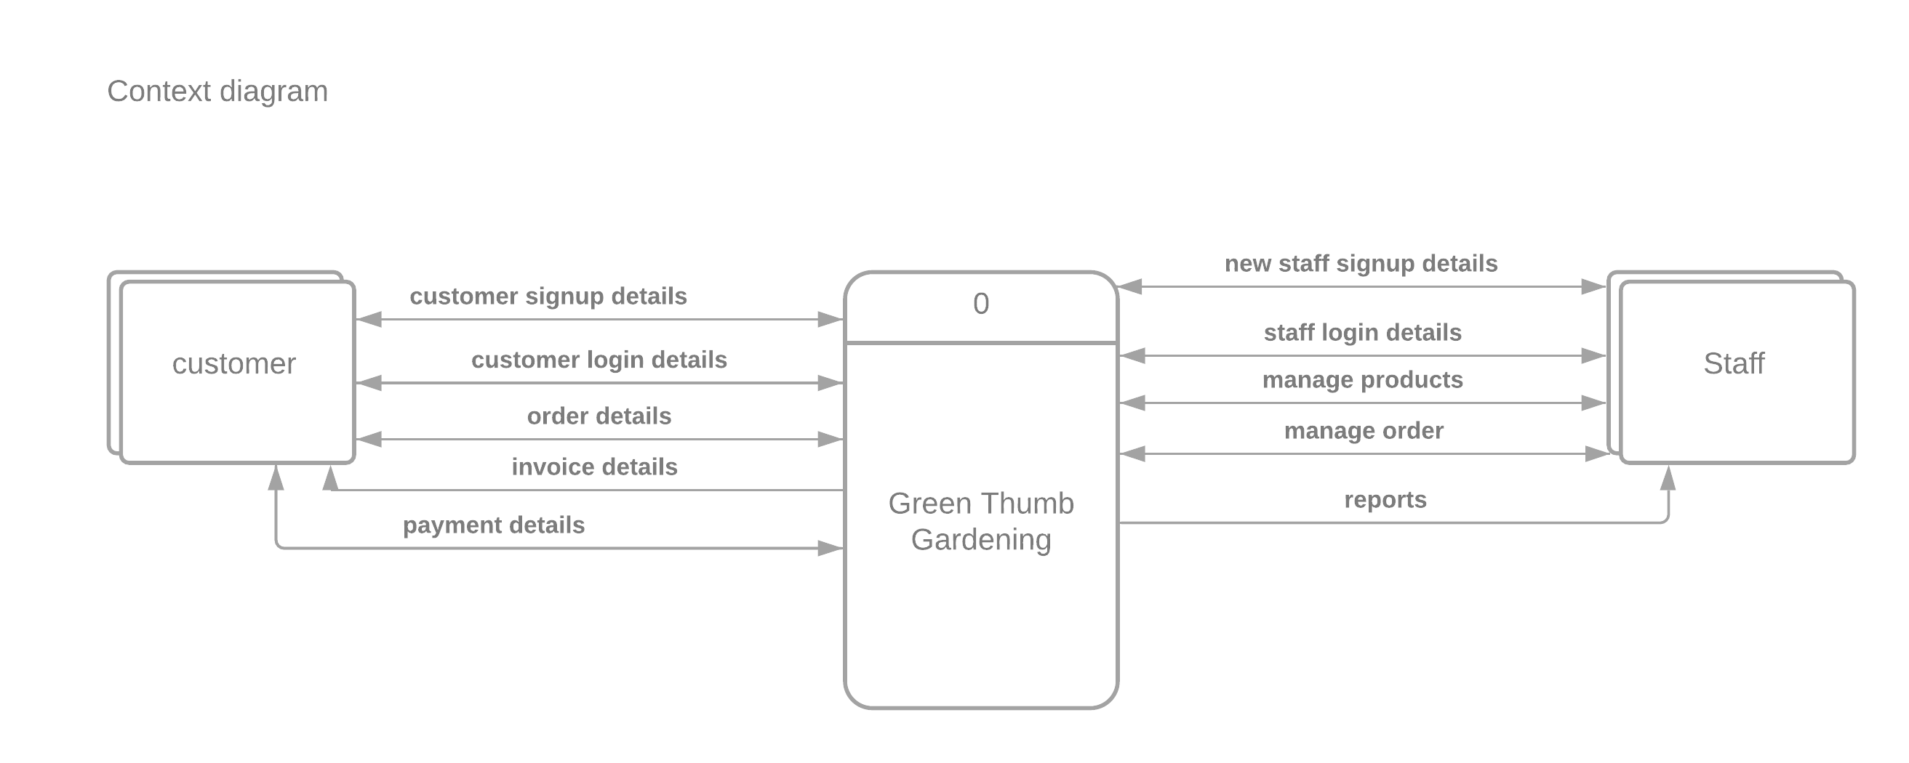
Context Diagram

Slide 24
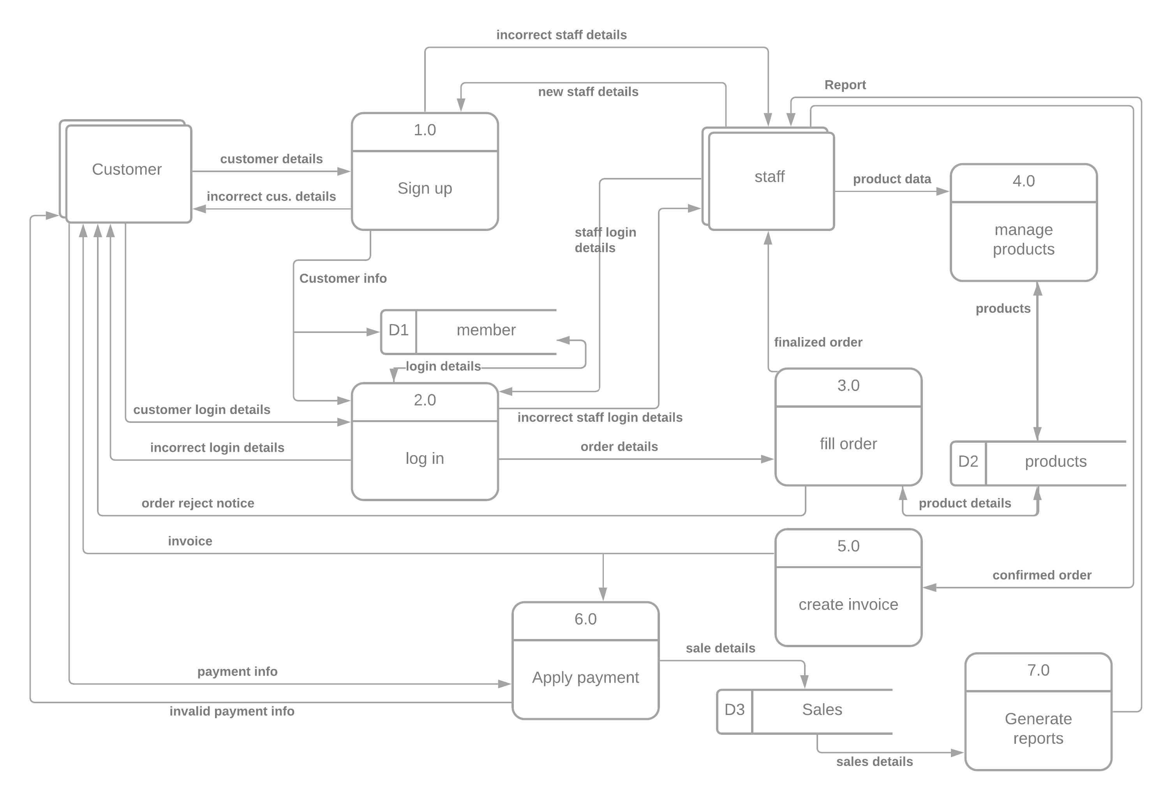
Data Flow Diagram Level 1

Slide 25
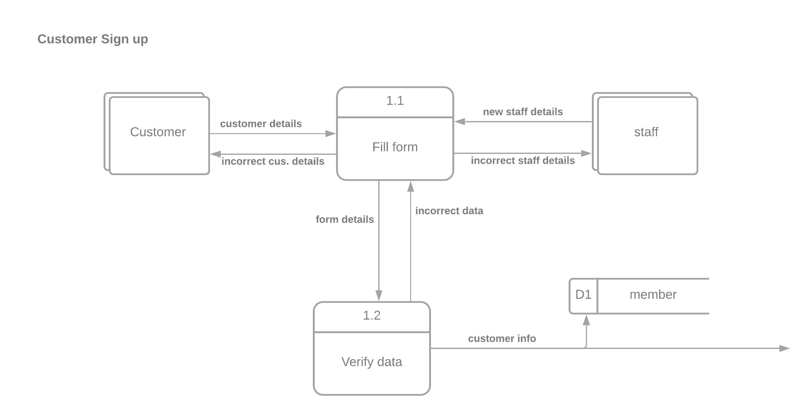
Level 2 DFDs

Slide 26
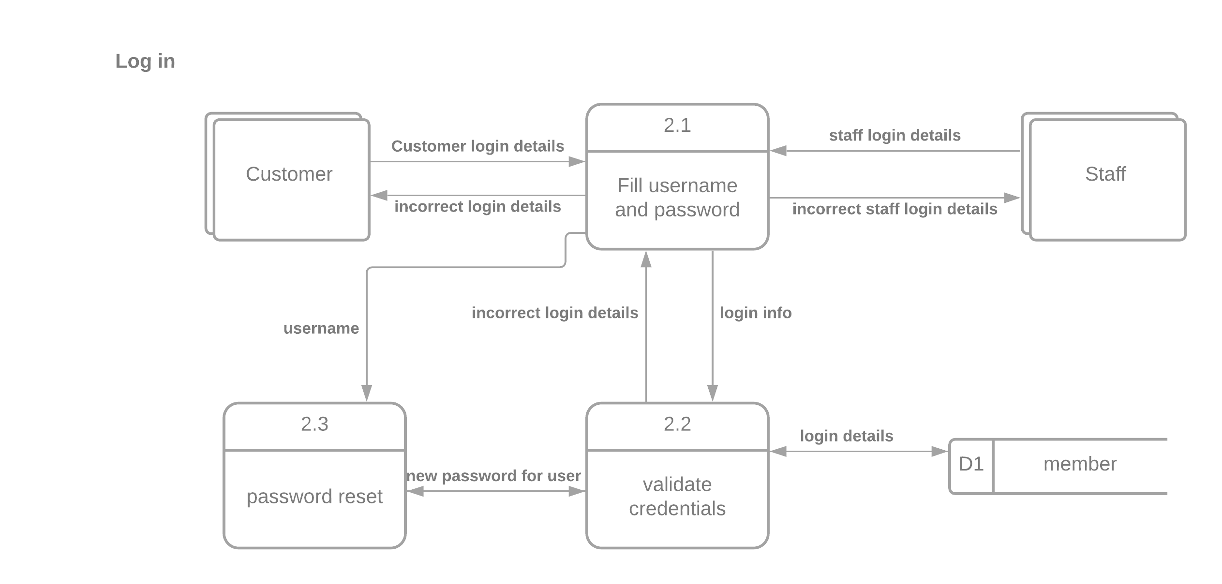
Continued…

Slide 27
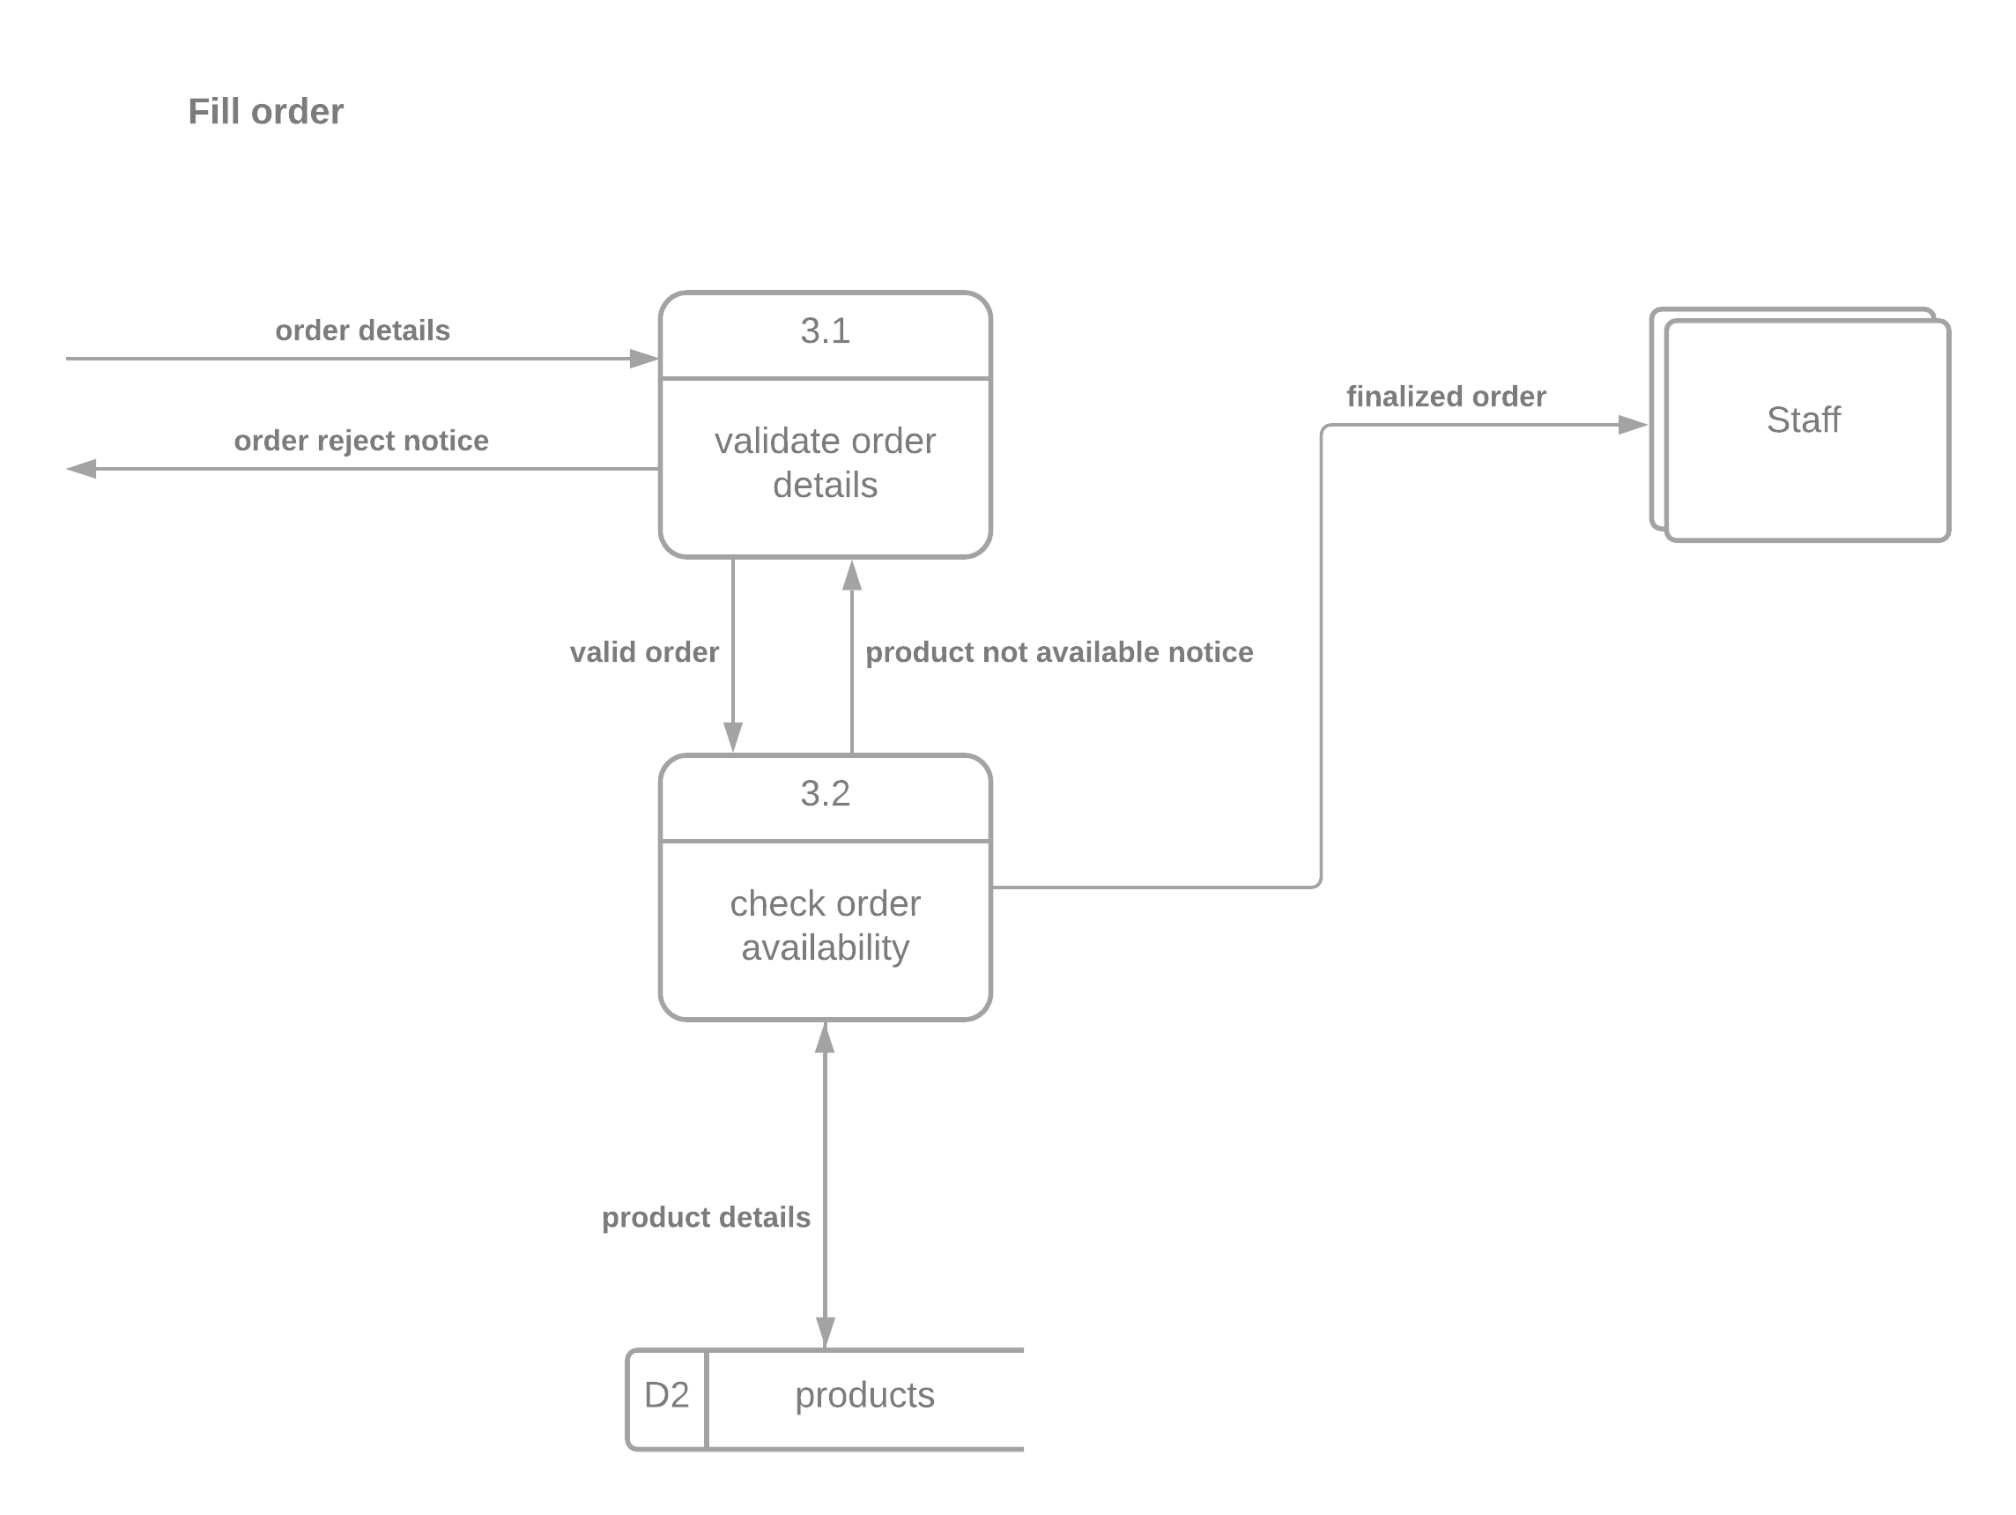
Continued…

Slide 28
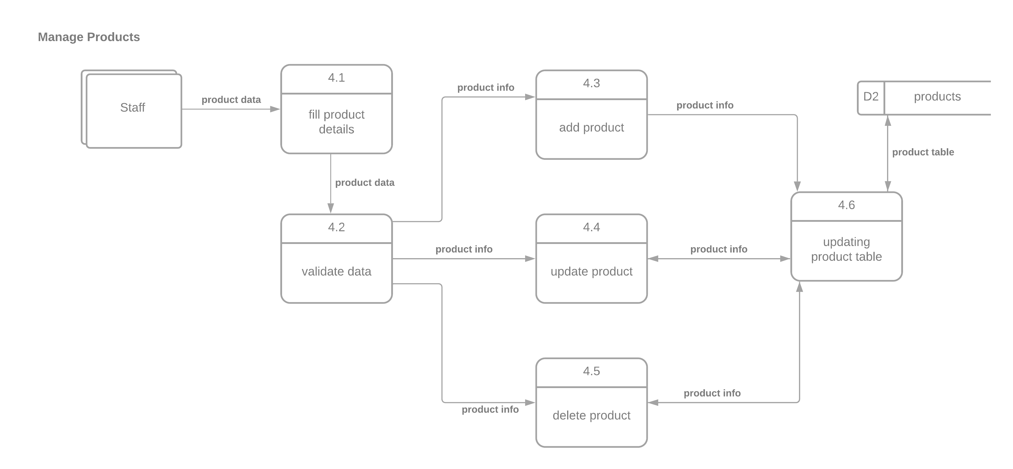
Continued…

Slide 29
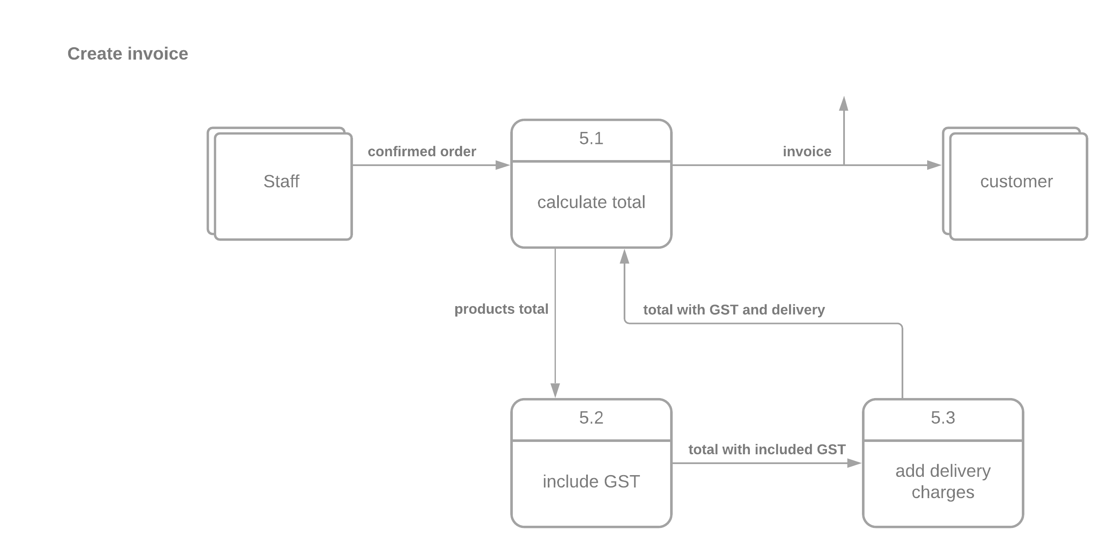
Continued…

Slide 30
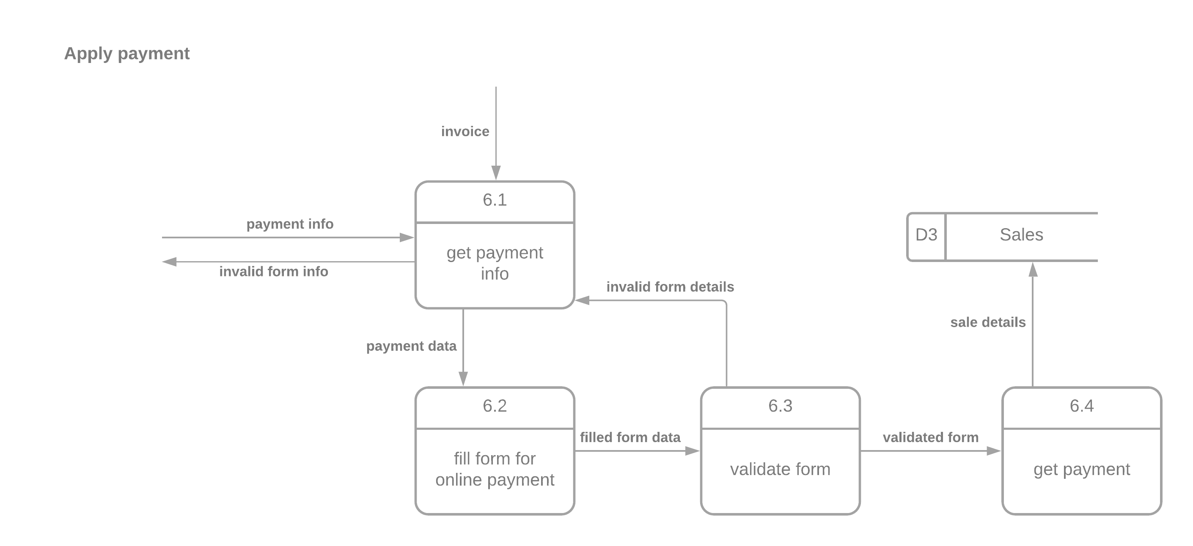
Continued…

Slide 31
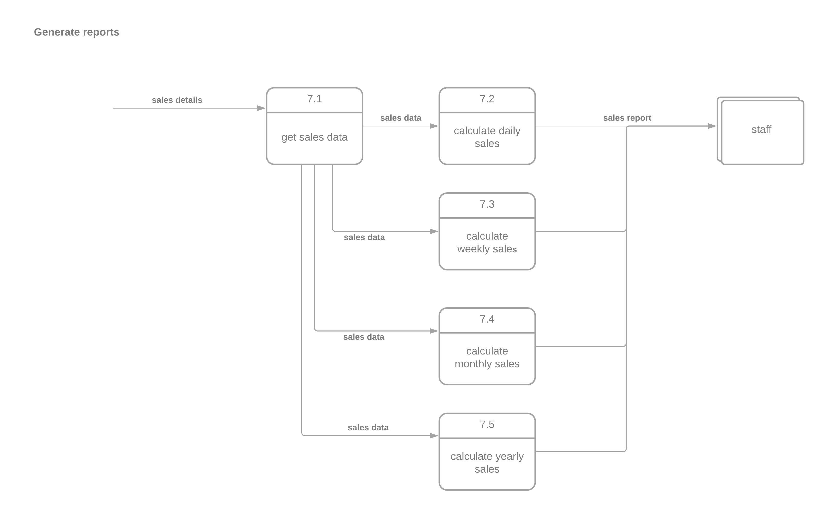
Continued…

Slide 32
Sequence diagrams

Slide 33
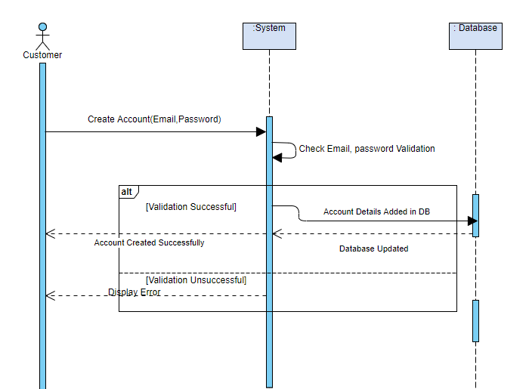
Customer Sign Up

Slide 34
Customer will enter his/her details on sign up page
The system will validate the email and password length
If the details are validate successfully, it will be saved in database
Account creation message will be displayed to customer

Slide 35
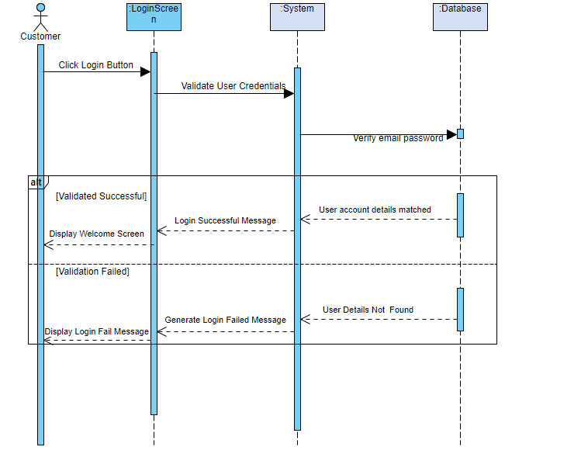
Customer Login

Slide 36
Customer will enter his/her credentials on login page
The system will verify it using the database
If the credentials gets matched in the database, successful login message will be shown to the customer

Slide 37
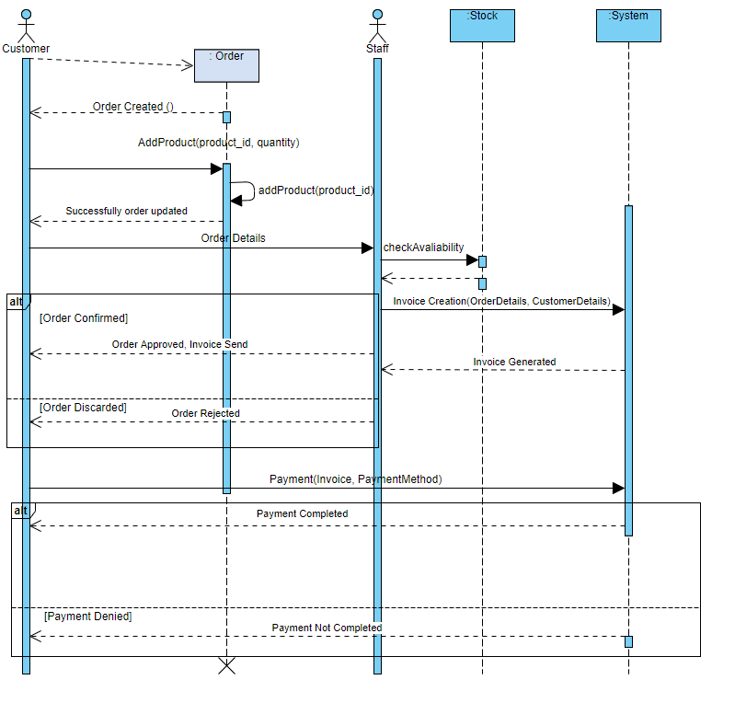
ORDER PLACEMENT

Slide 38
Customer will create an order, and can add multiple products
After Completing his/her order, the order details will be passed to the staff panel
Staff can check the availability of products
Based on availability the order might be accepted or rejected
If the order is expected then invoice will be generated
Customer now can choose payment method to pay online

Slide 39
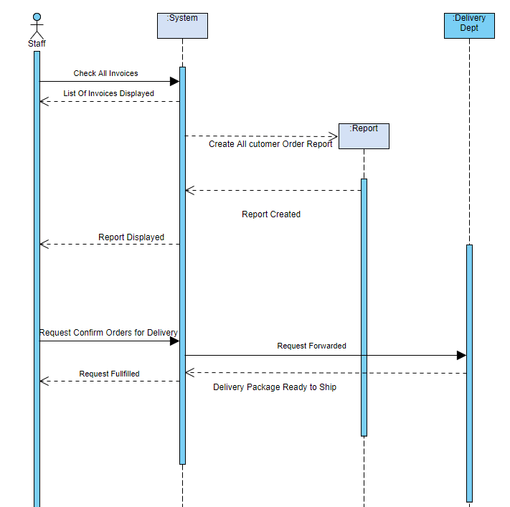
Report Generation

Slide 40
Staff can use the system to lookup or generate reports on daily, weekly and monthly basis
Upon successful generation of report the staff can analyze it.
Staff also has a responsibility to request delivery department to shipped order

Slide 41
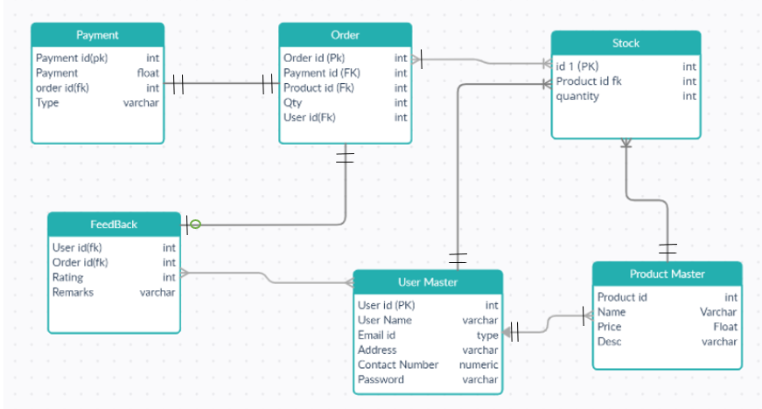
ER Diagram

